Slide 1
NATIONAL INSTITUTE OF TECHNOLOGY SRINAGAR
Statistical Analysis and
Machine Learning-Based Prediction of Wine Quality
Physicochemical properties • statistical inference • sampling • regression and neural networks
ORIGINAL DATA
CLEANED DATA
STATISTICAL FOCUS
ML TASK
1,599 rows
11 predictors + quality
1,359 unique rows
240 duplicate rows removed
Alcohol mean, CI,
hypothesis tests, sampling
Predict numerical quality
Regression problem
Research question: To what extent can the physicochemical properties of red wine explain variations in quality scores, and how accurately can machine learning models predict these scores?
NIT Srinagar | Data Analytics Project | Red Wine Quality
1 / 6

Slide 2
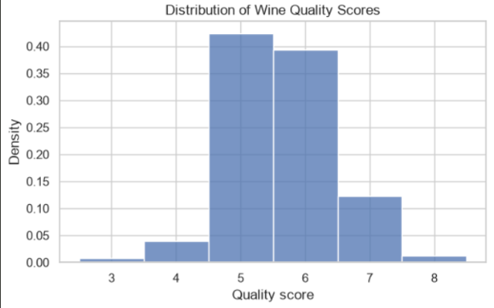
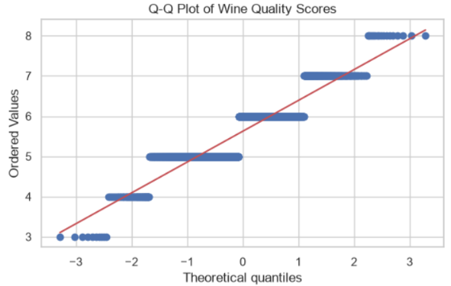
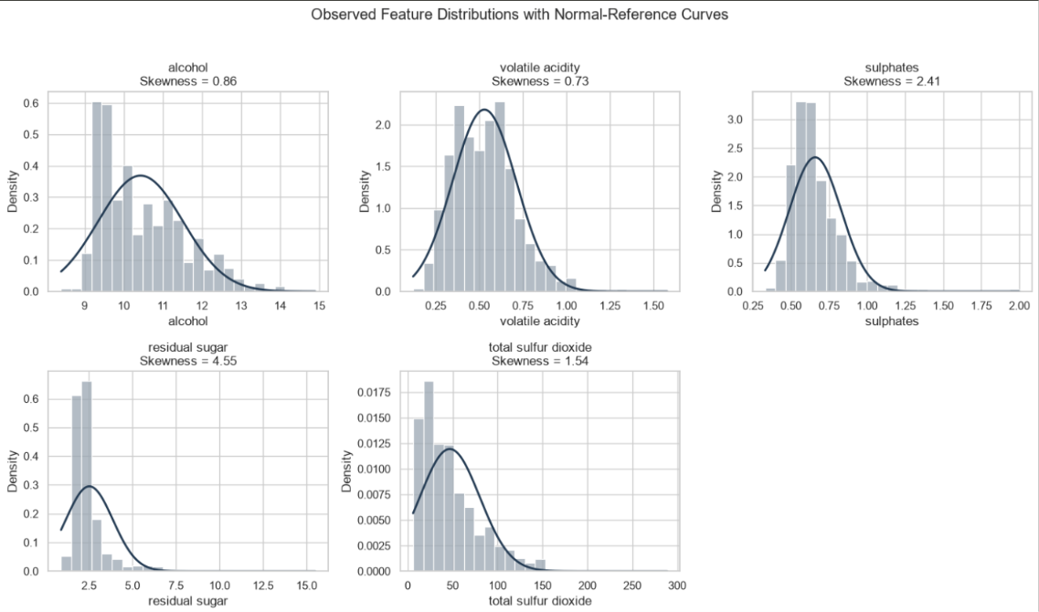
01 | DATASET AND DATA QUALITY
What does the dataset look like?
UCI Red Wine Quality • 1,599 original rows • 1,359 rows after exact-duplicate removal
DATA TYPES
ROWS
11 numerical physicochemical predictors; quality is a discrete numerical score.
1,599
original
PREPROCESSING
COLUMNS
12
No missing values. Removed 240 exact duplicate rows; duplicates were not automatically assumed to be errors.
11 features + target
INTERPRETATION
MISSING VALUES
Quality scores cluster around 5–6; rare scores are less represented. This is a discrete target distribution, not proof of normality.
0
no imputation
DUPLICATES
240
exact duplicate rows
NIT Srinagar | Data Analytics Project | Red Wine Quality
2 / 6

Slide 3
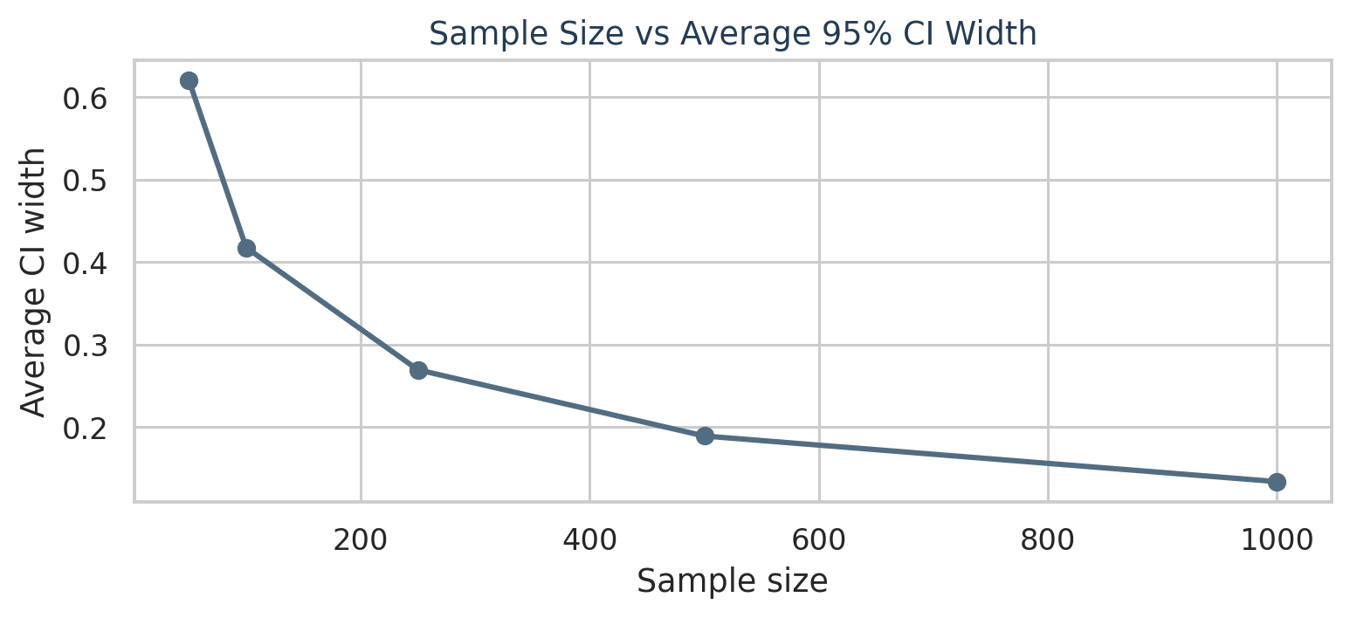
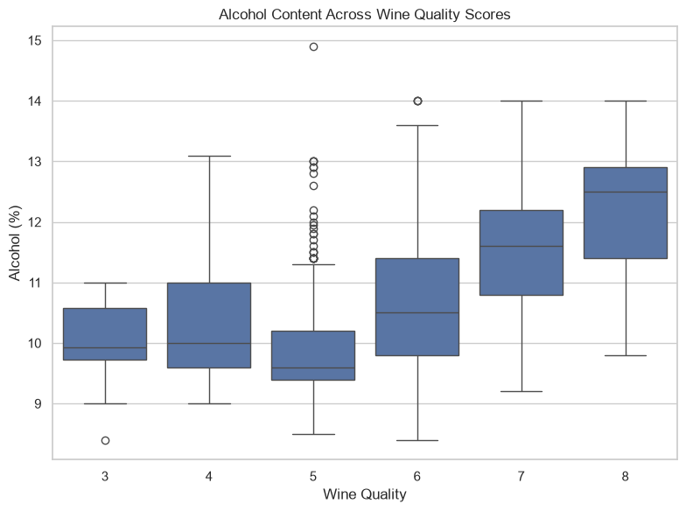
02 | STATISTICAL INFERENCE AND SAMPLING
Alcohol, hypothesis tests and sample-size effects
The notebook's observed results are shown below; statistical significance does not imply causation.
ALCOHOL MEAN
10.4323%
95% CI: 10.3747%–10.4899%
ONE-SAMPLE TEST
H₀: μ = 10%
t = 14.7284;
p ≈ 1.16 × 10⁻⁴⁵
Decision at α = 0.05: reject H₀
GROUP COMPARISON
Mean alcohol: quality ≤5 = 9.9208%; quality ≥6 = 10.8876%.
Welch test: p ≈ 1.80 × 10⁻⁶⁹
Decision at α = 0.05: reject H₀
SAMPLING AND CLT
Repeated samples fluctuate around the cleaned-data mean. As n increases, the standard error and average CI width generally shrink. CLT describes the sampling distribution of the mean—not the original feature distribution.
CORRELATION
r = 0.4803
Sampling method: SRS is a baseline; stratification by quality can preserve rare-score representation. For population estimates, account for stratum proportions.
alcohol vs quality
3 / 6

Slide 4
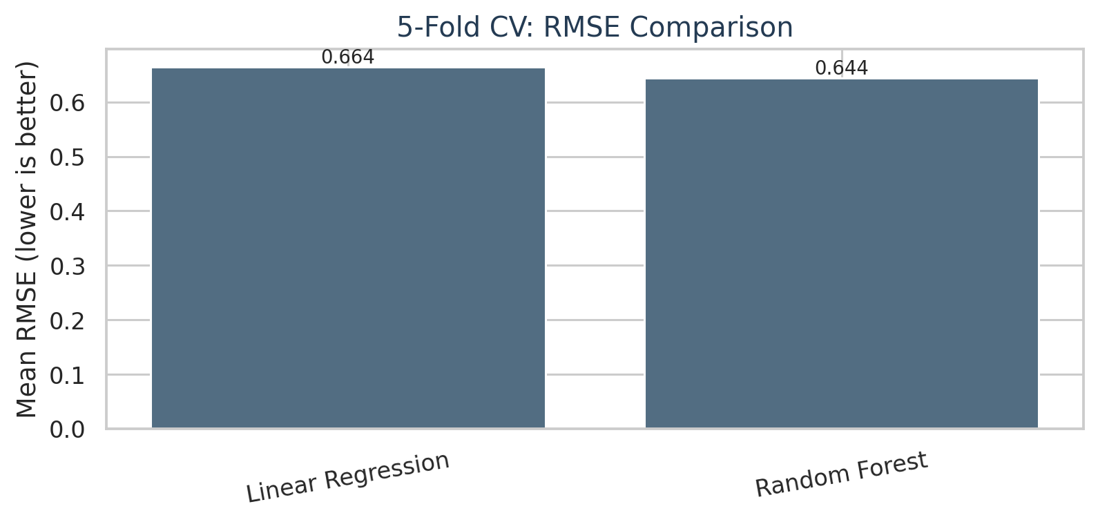
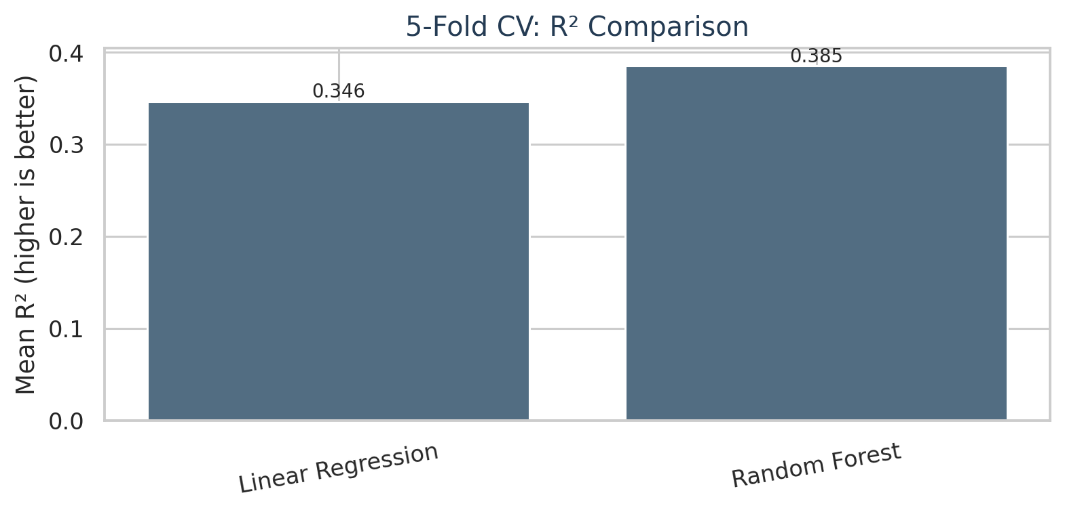
03 | MACHINE LEARNING
Regression baseline results
Five-fold shuffled cross-validation • target = numerical quality score
Model | MAE ↓ | MSE ↓ | RMSE ↓ | R² ↑
Linear Regression | 0.5118 | 0.4417 | 0.6645 | 0.3465
Random Forest | 0.4931 | 0.4150 | 0.6440 | 0.3853
WHY RANDOM FOREST MAY HELP
It can capture nonlinear patterns and feature interactions. The result supports better performance on these folds, but does not prove a single cause.
Interpretation: Random Forest has lower error and higher R² than Linear Regression in the current notebook. R² = 0.3853 is not 38.5% accuracy.
NIT Srinagar | Data Analytics Project | Red Wine Quality
4 / 6

Slide 5
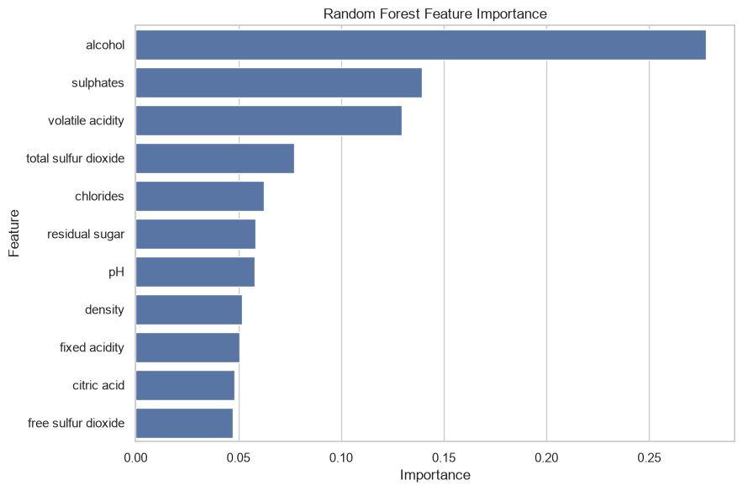
04 | INTERPRETATION AND MODEL EXTENSION
What matters, what remains uncertain
Feature importance is predictive association, not a causal explanation.
CURRENT FINDING
Alcohol has the highest Random Forest feature importance (0.2777), followed by sulphates (0.1392) and volatile acidity (0.1295).
LIMITATIONS
R² ≈ 0.385 means substantial variation remains unexplained. Observational data cannot establish causality; duplicate removal changes the dataset weighting.
NEXT MODEL COMPARISON
Add Ridge, Extra Trees, Gradient Boosting and an MLP neural network. Use the same 5-fold splits and compare MAE, RMSE and R². Report results only after running the extension code.
For viva: regression uses MAE/RMSE/R². A confusion matrix belongs to a separate classification experiment, e.g. quality ≤5 vs ≥6.
NIT Srinagar | Data Analytics Project | Red Wine Quality
5 / 6

Slide 6
05 | CONCLUSION AND REFERENCES
Key conclusions
A compact summary of the evidence currently available in the notebook.
STATISTICS
SAMPLING
The cleaned-data mean alcohol content is 10.4323%; its 95% CI is 10.3747%–10.4899%. The mean differs statistically from 10% at α = 0.05.
Across 30 repetitions, larger sample sizes produced narrower average confidence intervals and more stable sample means.
MACHINE LEARNING
CAUTION
Random Forest outperformed Linear Regression in the current five-fold CV comparison, but prediction performance remains moderate.
No causal claim. The primary task is regression; classification metrics should be presented only for a separately defined binary target.
References
1. UCI Machine Learning Repository. Wine Quality Dataset. https://archive.ics.uci.edu/dataset/186/wine+quality
2. Khan et al. (2025), “Improved machine learning framework with feature engineering and SHAP analysis for predicting wine quality,” Discover Applied Sciences (verify bibliographic details before submission).
NIT Srinagar | Data Analytics Project | Red Wine Quality
6 / 6

